Slide 1
The Holocaust
CHAPTER 16
WORLD WAR LOOMS 1931 – 1941

Slide 2
The Holocaust
Europe has a long history of anti-Semitism
The German people believe Hitler’s claim and blame Jews for their problems and for the lost of World War I
April 4, 1933, Hitler removed all non-Aryans from the government
Nazis take away citizenship, jobs, property and were require to wear the Star of David
  1935, Nuremberg Laws stripped Jews of their civil rights & property if they left Germany

Slide 3
Kristallnacht
The Night of Broken Glass
November 9, 1938,
Nazis attack Jewish homes, businesses and synagogues
About 100 Jews killed, hundreds injured, and 30,000 arrested
The Nazis blamed the Jews for the destruction

Slide 4
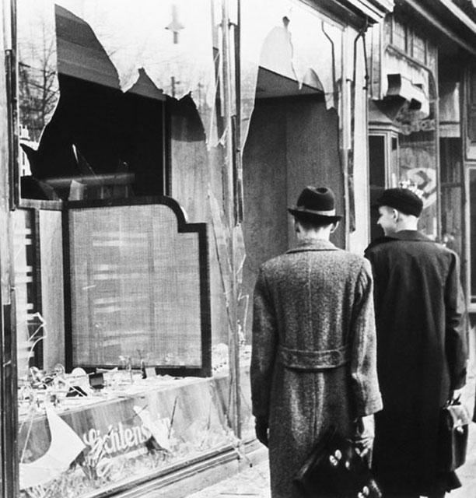
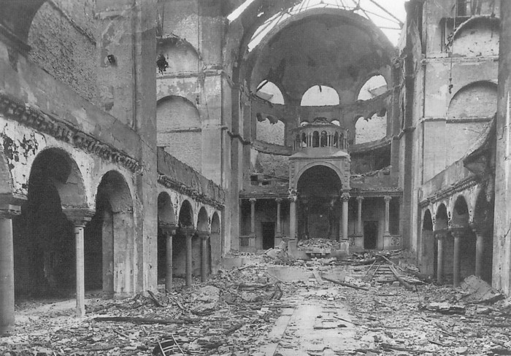
Kristallnacht
The Night of Broken Glass

Slide 5
Hitler’s “Final Solution”
Slavery and genocide of “inferior” groups
Health Jews were sent to labor camps, rest were sent to extermination camps
The targets; Jews, gypsies, freemasons, Jehovah’s Witnesses, all unfit Germans
Homosexuals, MR, insane, disabled & incurably ill
Nazi death squads round up Jews and shot them

Slide 6
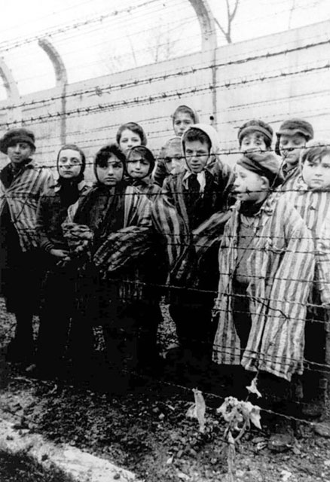
Concentration Camps
Many Jews were taken to concentration camps or labor camps
Camps originally were prisons and given to the SS to warehouse the “undesirables”

Slide 7
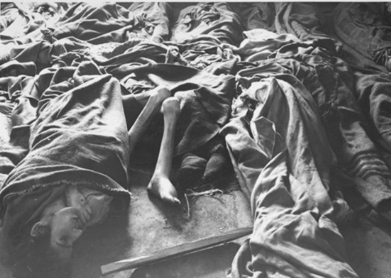
Concentration Camps
Prisoners crammed into wooden barracks and given very little food
They work from dawn to dusk, 7 days per week
Those too weak to work are killed

Slide 8
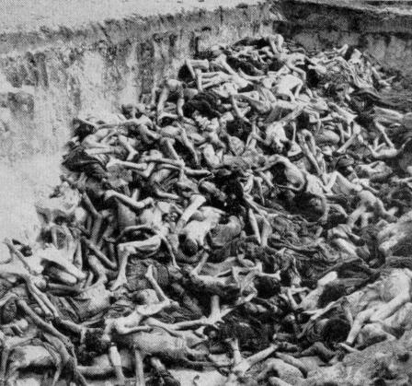
Death Camps
Germans build death camps and gas chambers used to kill thousands
At first bodies are buried in pits; later they are cremated to cover up evidence

Slide 9
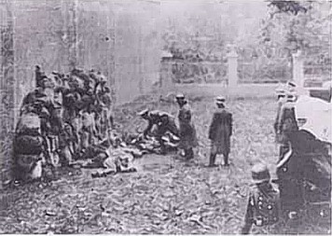
Death Camps
Some are shot, hanged, poisoned or die from horrible medical experiments

Slide 10
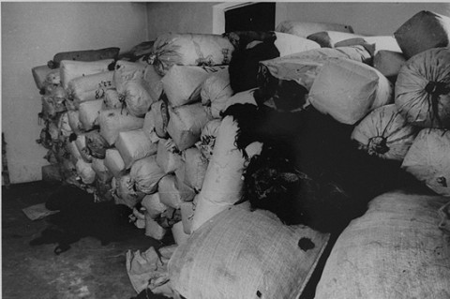
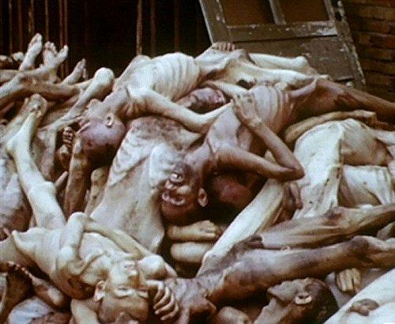
Death Camps

Slide 11
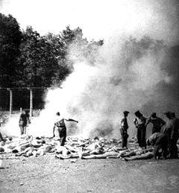
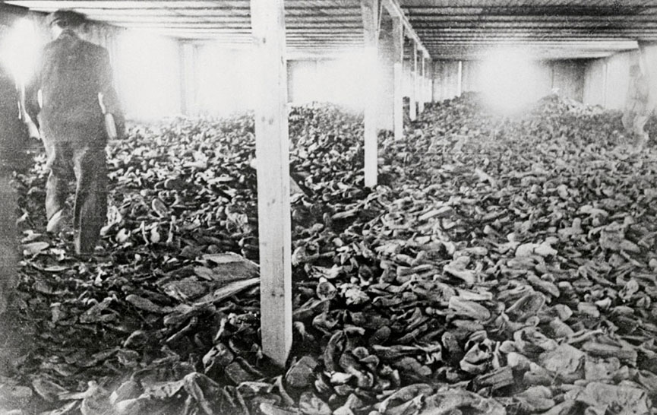
Death Camps

Slide 12
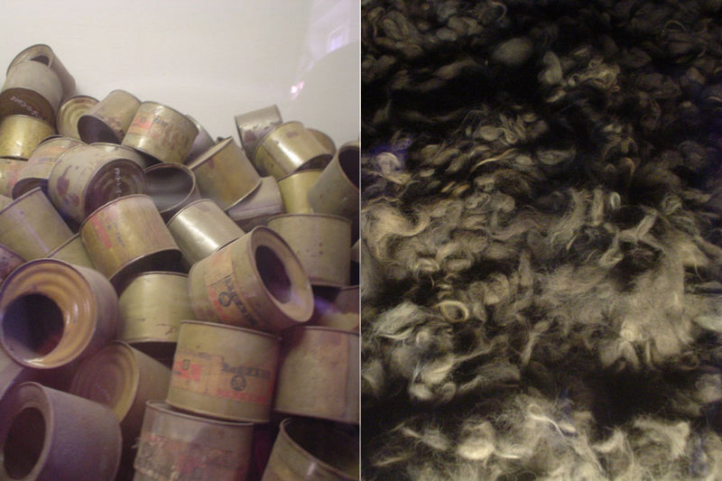
Death Camps

Slide 13
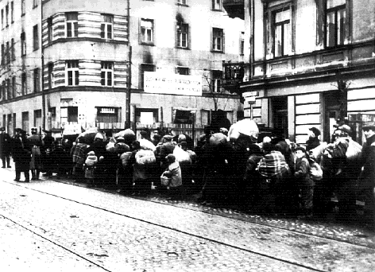
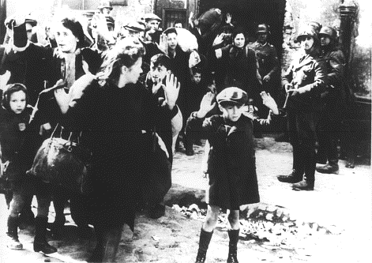
Warsaw, Poland

Slide 14
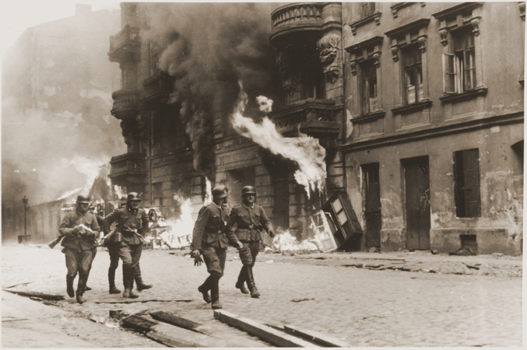
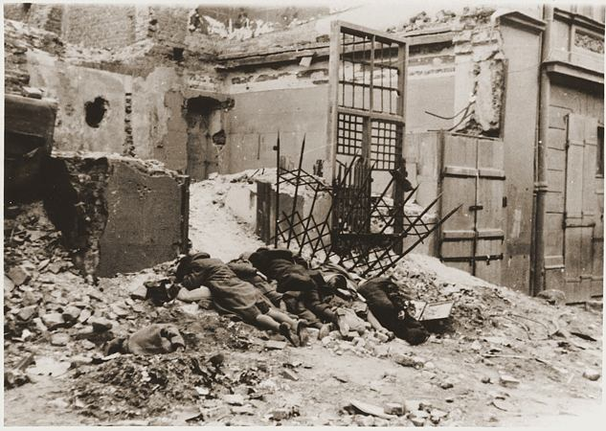
Warsaw Uprising

Slide 15
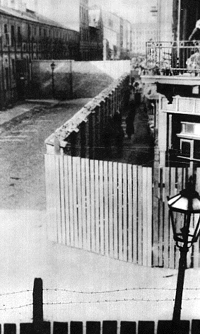
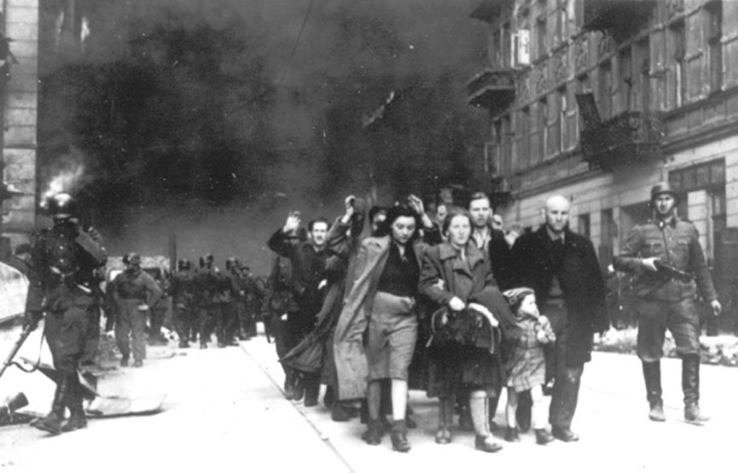
Warsaw Uprising

Slide 16
Killings by Years
Year | Killed
1933 to 1940 | Under 100,000
1941 | 1,100,000
1942 | 2,700,000
1943 | 500,000
1944 | 600,000
1945 | 100,000

Slide 17
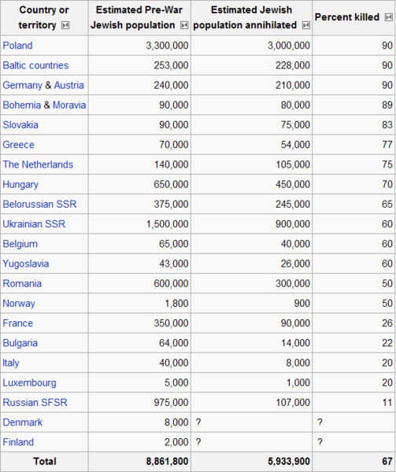
The Holocaust

Slide 18
Chapter 16 Section 3 Quiz
1.) What was the name given for the killing of 11 million non-Aryans across Europe by Adolph Hitler’s regime?
a.) Blitzkrieg
b.) The Holocaust
c.) German Massacre
2.) What did the Germans blame the Jews for?
a.) Claiming they were a superior race
b.) Attacking German soil
c.) Their loss in World War 1
3.) What type of person was targeted the most by the Nazi’s?
a.) Americans
b.) Russians
c.) Jews
4.) What laws in 1935 allowed Nazi’s to take away Jews land, property and citizenship?
a.) Nuremburg laws
b.) Anti immigration laws
c.) Blitzkrieg Laws
5.) What name was given to the military men that attacked the Jewish homes?
a.) Kristallnaught
b.) Hitler’s men
c.) The Red Army Soldier
6.) What did Hitler call his military men?
a.) German Marines
b.) Blitzkrieger’s
c.) Storm Troopers
7.) Name one fact about the immigration of Jews to other countries.
a.) Other countries gladly took in all Jews
b.) Other countries limited the amount of Jews they took in
c.) The Jewish population was exterminated during the Holocaust
8.) What people were condemned by Hitler?
a.) Americans
b.) Jews
c.) Italians
9.) What was Hitler’s belief?
a.) All men were created equal
b.) The White Jewish race was the superior race
c.) The white race was the master race
10.) What happened to the condemned?
a.) They were sent to Ghetto’s
b.) They were sent to live in America
c.) They were forced to serve in the German army

Slide 19
Chapter 16 Section 3 Quiz con’t.
11.) What happened to the mentally ill?
a.) Hitler felt sorry for them and let them be
b.) They were condemned
c.) They were forced to join the Nazi army
12.) What were guarded areas in Polish cities called?
a.) Ghetto’s
b.) Shantytowns
c.) Concentration Camps
13.) What were the Ghetto’s guarded by?
a.) Nothing
b.) Barbed wire and stone walls
c.) Allied troops providing protection against the Nazi’s
14.) What were living conditions in Ghetto’s like?
a.) Very good
b.) Very bad
c.) Average
15.) What happened to most Jews that were not sent to the Ghetto’s?
a.) They were sent to America to live
b.) They were forced to serve in the Nazi army
c.) They were sent to concentration camps
16.) What happened to Jewish families?
a.) They all stayed together
b.) They were separated
c.) They all were forced to serve in the German military
17.) What happened to someone who did not agree with the Nazi’s?
a.) They were imprisoned in concentration camps
b.) They were saved due to Hitler appreciating their bravery
c.) They were sent to America to live
18.) What type of things were people in concentration camps forced to deal with?
a.) Constant Hunger
b.) Humiliation
c.) Both
19.) What were the concentration camps barracks made of?
a.) Steel
b.) Wood
c.) Sod
20.) Describe living conditions in the barracks?
a.) They were crowded
b.) They were comfortable
c.) They were made to make people feel like they were back home

Slide 20
Chapter 16 Section 3 Quiz Con’t.
21.) Describe the size of the barracks?
a.) Big
b.) Small
c.) Average size
22.) Name one way that Jews were killed in the concentration camps.
a.) Mass slaughter
b.) Lethal injection
c.) Electric chair
23.) Name one way that Jews were killed in the concentration camps.
a.) They were hung
b.) Starvation
c.) Chopping Block
24.) Name one way that Jews were killed in the concentration camps.
a.) They were stoned to death
b.) Poisoned gas
c.) They were forced to fight each other until death
25.) How many Jews died in the concentration camps?
a.) about 600,000
b.) about 6 million
c.) about 6000
26.) What were people who were sent to gas chambers told they were going to do?
a.) They were told they going to take a shower
b.) They thought they were going to work
c.) They were told they were being sent back home
27.) Name one thing Nazi doctors did to some Jews?
a.) They cured cancer in them
b.) They created the AIDS virus in them
c.) They performed experimental surgeries on them
28.) Why did the Nazi’s inject a lot of the Jews in the camps with germs?
a.) To see how humans react to the germs
b.) To save the lives of the Jews
c.) The save the Jewish race
29.) How did the Nazi’s hide a lot of the evidence of the Holocaust?
a.) By bombing each Concentration camp with a nuclear weapon
b.) By burning down each Concentration camp
c.) By incinerating the bodies of the Jewish people they had killed
30.) Name a cruel thing that happened to some Jewish people in Concentration camps.
a.) They were sterilized
b.) They were dropped from airplanes during air raids
c.) They were forced to join the German army and become a Nazi

