Slide 1
Austria and Czechoslovakia Fall
1938, Hitler demanded that Austrian Chancellor von Schuschnigg appoint Nazis to government posts.
He agreed but changed his mind later
Hitler was upset and on March 12, 1938, German troops march into Austria unopposed

Slide 2
Austria and Czechoslovakia Fall
September 30, 1938, Prime Ministers Daladier, Neville Chamberlain meet with Hitler, Munich Conference
Sign the Munich Agreement, they hand Sudetenland over to Germany
Chamberlain “Peace for our time”

Slide 3
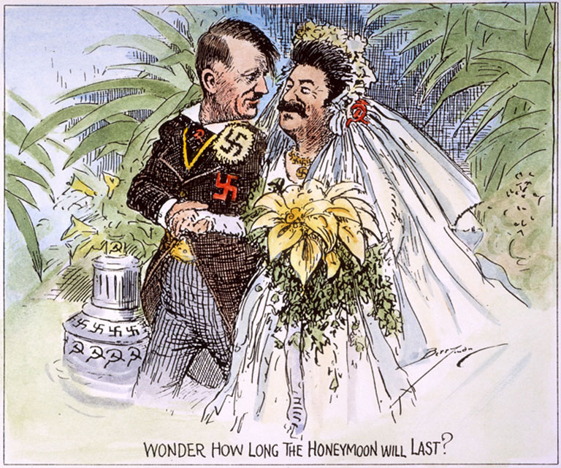
The Soviet Union Declares Neutrality
On August 23, 1939, Stalin and Hitler sign a nonaggression pact
The two will not attack each other
Sign a second, secret pact agreeing to divide Poland between them

Slide 4
The German Offensive Begins
September 1, 1939, Hitler overruns Poland in 3 weeks
Blitzkrieg, lighting war is new type of warfare
  1st Stage, Stuka dive-bombers pounded enemy positions, disrupted communication & compromise troop’s mobility
  2nd Stage, Infantry with tanks attack, ground combat

Slide 5
The German Offensive Begins
September 3, France and Britain declare war on Germany; World War II begins
Germany annexes western Poland; U.S.S.R. attacks, annexes east

Slide 6
The Phony War
For 7 month nothing happens, newspapers call it a Phony War
  few naval battles
April 9, 1940, Hitler invades Denmark, Norway, then the Low countries
  Netherlands, Belgium & Luxembourg (Low Countries)
French & British soldiers were put on the Maginot Line facing Germany

Slide 7
The Fall of France
May 14, 1940, German army goes through the Ardennes, bypassing the Maginot line & the bulk of the French and British soldiers, cutting them in half
Belgium, British & French were trapped at Dunkirk; soldiers were ferried to safety in UK
  338,000 troops escaped using 800 vessels
  Miracle of Dunkirk
Italy then invades France from the south, while the Germans approach Paris

Slide 8
The Fall of France
June 21, Paris falls to the Germans
Germans will occupy northern France
A Nazi puppet government was set up in southern France
  Marshall Philippe Petain was put in charge of the puppet government in Vichy
General Charles de Gaulle sets up a government-in-exile in England

Slide 9
The Battle of Britain (August of 1940 to June of 1941)
Summer of 1940, Germany prepares a fleet to invade Britain
To gain control of the skies, German planes bomb British bases & air fields Luftwaffe – German Air Force
Britain uses radar to track and shoot down German Planes
German planes pounded Great Britain ever night until one night a bomber bomb London by mistake.
This caused Great Britain to bomb Berlin

Slide 10
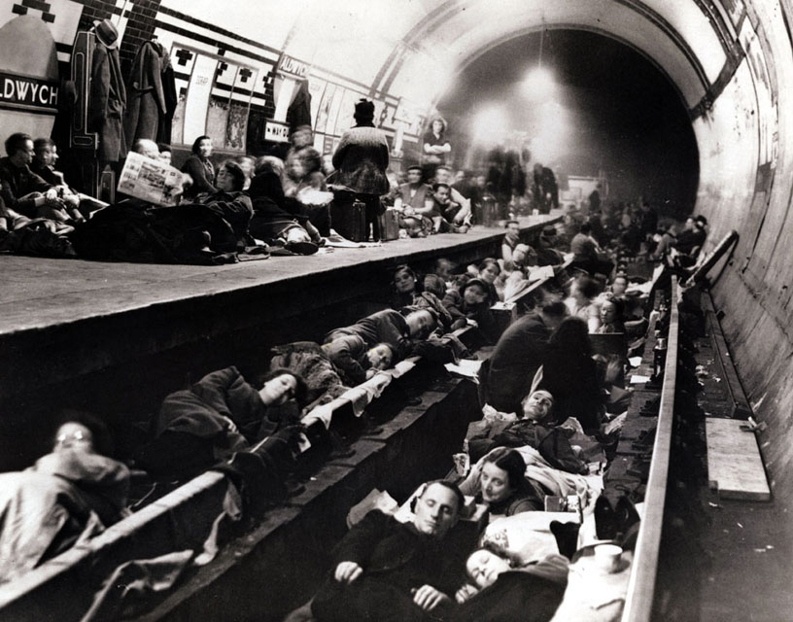
The Battle of Britain
People in London started living in the subways or anything underground
  children were sent to the country
By October Hitler calls of the invasion of G.B.
Germans and the British continue to bomb each other’s cities

Slide 11
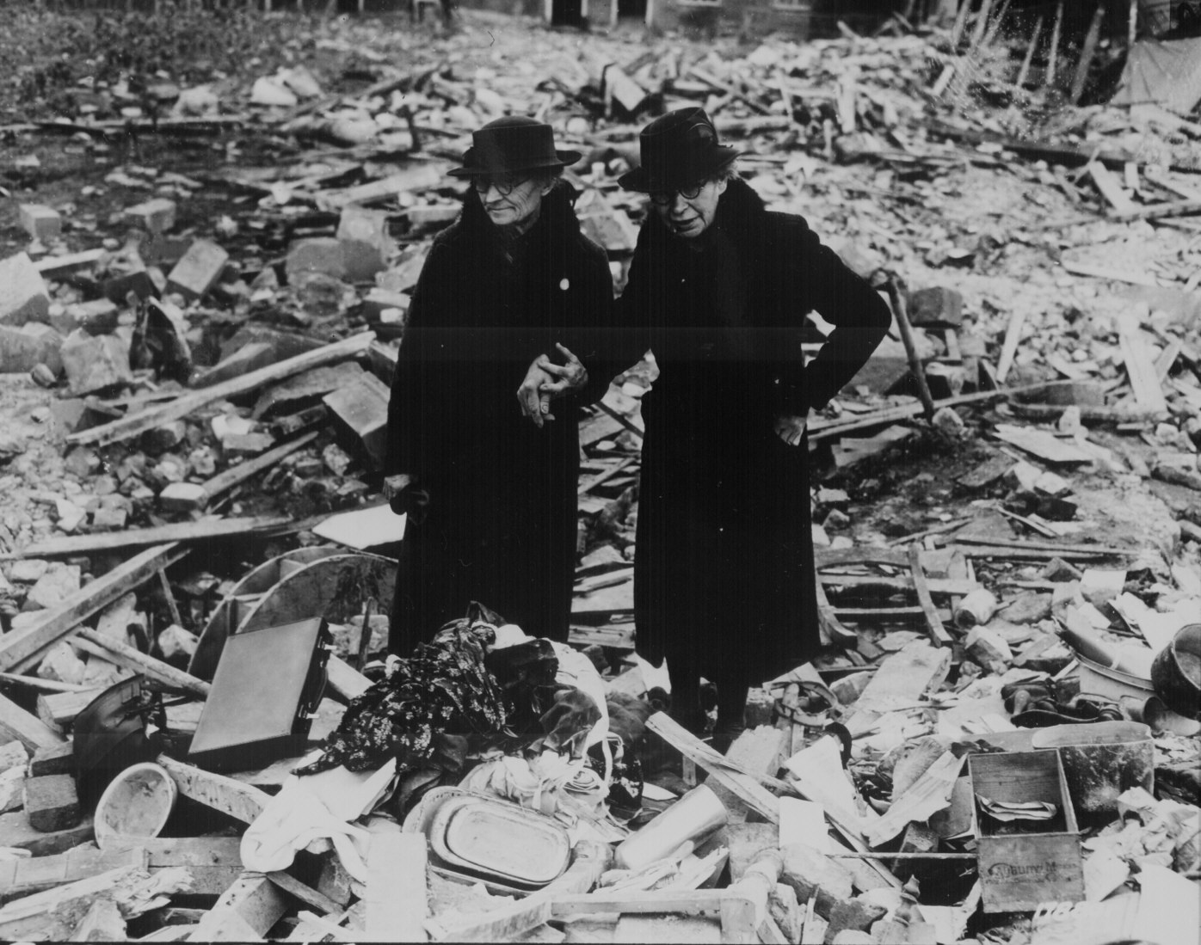
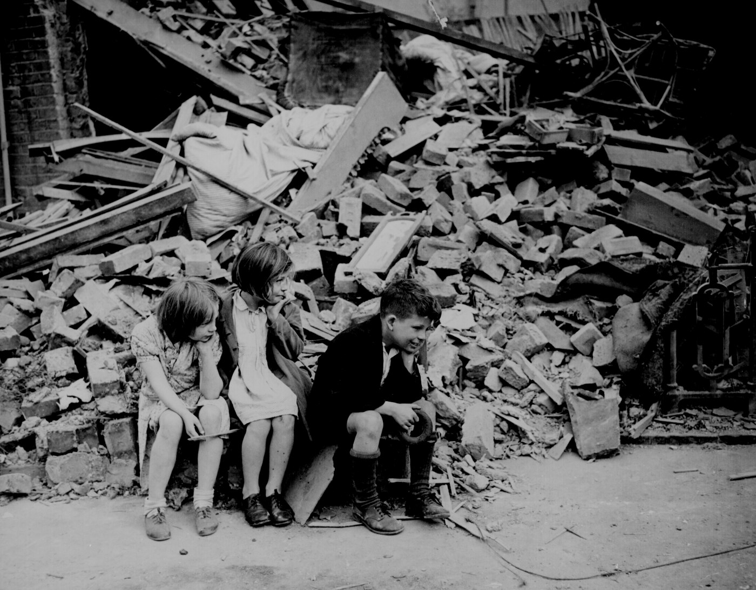
The Battle of Britain

Slide 12
Chapter 16 Section 2 Quiz
1.) What were the U.S.’s view of the war?
a.) The neutrality act was passed to get involved in the war
b.) The neutrality act was passed to support Germany in the war
c.) The neutrality act was passed to avoid the war
2.) At what point was it impossible for America to remain neutral?
a.) When Japan attacked China
b.) When China attacked Japan
c.) When Germany attacked U.S. soil
3.) What country was Hitler’s first target?
a.) Austria
b.) Russia
c.) Poland
4.) What country was Hitler’s second target?
a.) Poland
b.) Czechoslovakia
c.) Russia
5.) What two countries joined into a secret agreement and split Poland?
a.) Russia and Germany
b.) France and Great Britain
c.) U.S. and France
6.) Name the term used to describe Russia and Germany’s attack of Poland?
a.) Quick attack
b.) Blitzkrieg
c.) Axis invasion
7.) Who did the Italians side with?
a.) France and Great Britain
b.) The U.S.
c.) The Germans
8.) What technology helped the British find the German planes?
a.) Radar
b.) Sonar
c.) Telescope

