Slide 1
Five Turning Points of World War II
1942
Battle of Midway halts the Japanese expansion in the Pacific
1942-1943
Battle of Stalingrad ends Nazi advances in Europe
1942
Battle of l Alamein begins Allied offensive against the Axis powers in North Africa
1944
D-Day invasion opens second front in Europe, paving the way for final defeat of Germany
1945
Manhattan Project develops atomic bomb, used to end the war in the Pacific

Slide 2
World War II Deaths, Selected Nations, Axis
Country | Military Deaths | Civilian Deaths
German | 3,500,000 | 780,000
Italy | 242,000 | 153,000
Japan | 1,300,000 | 672,000

Slide 3
World War II Deaths, Selected Nations, Allies
Country | Military Deaths | Civilian Deaths
France | 213,000 | 350,000
Britain | 264,000 | 93,000
China | 1,310,000 | 1,000,000
Soviet Union | 7,500,000 | 15,000,000
United States | 292,000 | 6,000

Slide 4
Internment of Japanese Americans
Hawaii governor forced to order internment (confinement) of Japanese Americans (Nisei)
1942, FDR signs the removal of Japanese Americans in four states
U.S. Army forces 110,000 into prison camps
1944, Korematsu v. United States – Court rules in favor of internment
After war, Japanese American Citizens League pushes for compensation
1988, Congress grants $20,000 to everyone sent to relocation camp (38 million total)

Slide 5
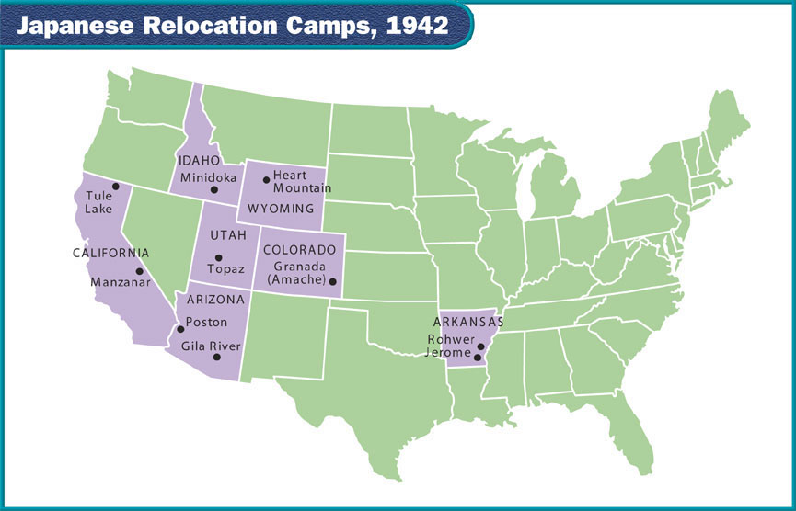
Internment of Japanese Americans

Slide 6
